Slide 1

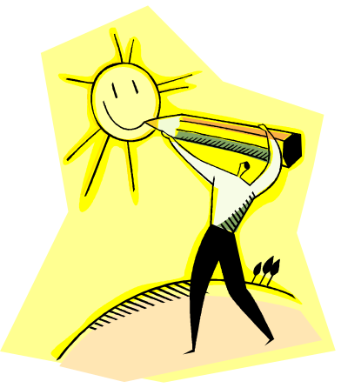
Emotion Rating Scale
One of my students was having a hard day and I asked him to let me know what he was feeling. He pointed to the smiley face and I asked, “Why?” knowing that he wasn’t happy at that time.
He said, “This is how I want to feel.”
Brenda Faubion
Lometa ISD, Texas

