Slide 1
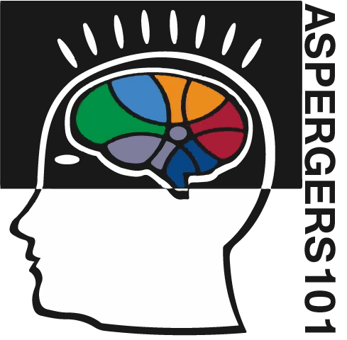



Summer Series Presents:
Asperger Syndrome:
From Diagnosis to Independence

Slide 2


Social Development
Summer Series Presents:
Asperger Syndrome:
From Diagnosis to Independence

Slide 3

Dr. Temple Grandin

Slide 4
What is Autism/Asperger Syndrome?

Slide 5
Asperger Syndrome
Asperger Syndrome is one of several previously separate subtypes
of autism that were folded into the single diagnosis autism
spectrum disorder (ASD) with the publication of the DSM-5
diagnostic manual in 2013.

Slide 6
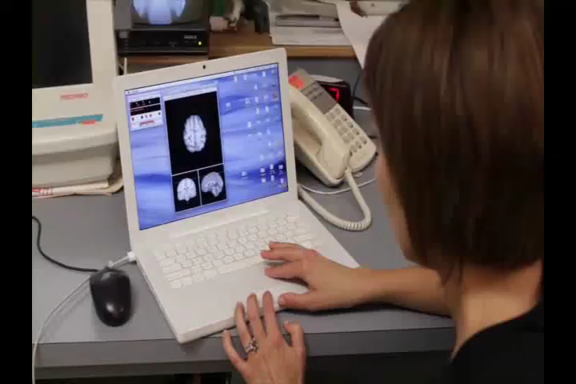
with Dr. Janessa Manning

Slide 7
Possible Behaviors
The following behaviors are often associated with Asperger Syndrome.
However, they are seldom all present in any one individual
and vary widely in degree:
• limited or inappropriate social interactions
• "robotic" or repetitive speech
• challenges with nonverbal communication (gestures, facial
expression, etc.) coupled with average to above average verbal skills
• tendency to discuss self rather than others
• inability to understand social/emotional issues or nonliteral phrases
• lack of eye contact or reciprocal conversation
• obsession with specific, often unusual, topics
• one-sided conversations
• awkward movements and/or mannerisms

Slide 8
Social Development

Slide 9
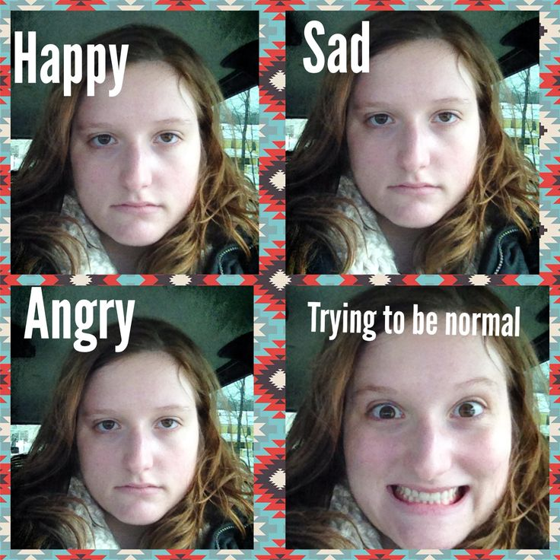
Alix Generous

Slide 10


Challenges with Conversation
excerpt from documentary “Coping to Excelling”

Slide 11


Slide 12
Remember when communicating with someone diagnosed with ASD…
They know what they want and don’t want.
They know what they want to get across.
They know what they feel.
What they may find challenging is finding a way to let us know what those thoughts and feelings are.

Slide 13
Strategies for Improving Social Integration

Slide 14
1. Opportunities to interact with neuro-typical children
The first strategy is to ensure the child has opportunities
to observe and interact with mainstreamed children at their school.
This is to ensure that their peers not only demonstrate appropriate
social/emotional behavior but also are sufficiently socially skilled
to know how to modify their social behavior in order to accommodate
and support the child with Asperger's Syndrome. Some children with
Asperger's Syndrome attend schools for emotionally disturbed children;
such circumstances may not provide an appropriate peer group.

Slide 15
2. Knowledge of the nature of Asperger's Syndrome
As children with Asperger's Syndrome have no distinct physical
characteristics to indicate their disorder and their intellectual and
physical abilities are perceived as within the normal range, other
people may not be able to conceptualize the genuine difficulties
the child has with the social/emotional aspects of life. Their
errors in the skills necessary for social integration can be
misinterpreted as having deliberate malevolent intent.
Reference: This paper was originally published in the journal autism, volume 4, pages 85-100.
The journal is published by SAGE and the National Autistic Society.

Slide 16
3. Imitation
Some individuals with Asperger's Syndrome can be quite ingenious
in using imitation and modeling to camouflage their difficulties with
social integration.
Conventional speech and drama lessons can be used to
encourage the child how to act in social situations. The child
observes someone who is competent in social integration skills
in natural settings, and watches video taped examples, taking
note of what they do and say.
Reference: This paper was originally published in the journal autism, volume 4, pages 85-100.
The journal is published by SAGE and the National Autistic Society.

Slide 17
4. Social Skills Groups
This strategy provides group tuition on why certain skills
are important and practice applying those skills using modeling,
role play, video recordings and constructive feedback. Look for social
skills groups in public school and through area autism organizations.
Reference: This paper was originally published in the journal autism, volume 4, pages 85-100.
The journal is published by SAGE and the National Autistic Society.

Slide 18
Dr. Louise O’Donnell
UT Health Science Center
San Antonio

Slide 19
Social-Emotional Development
Louise O’Donnell, Ph.D.
Neuropsychologist and Assistant Professor
UT Health
Departments of Psychiatry and Pediatrics

Slide 20
Development
  Infants/children/adolescents are qualitatively and quantitatively different from adults
  Must be knowledgeable about range of normal variation at each age level to correctly intervene when necessary
Notes:
Is it a delay or an absence of development?

Slide 21
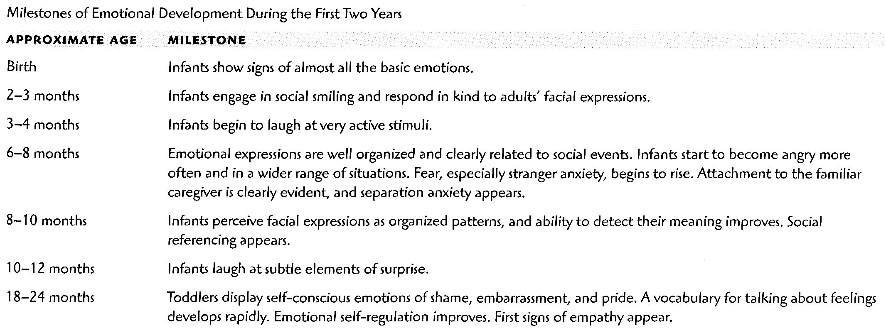
Social emotional development
Notes:
Babies are designed to be social creatures. Read slide.

Slide 22
Anatomical elements of the social brain
Location
Function
Superior temporal sulcus
Orbital frontal cortex
Fusiform gyrus
Amygdala
Analyzes motion cues (eyes, hand, body) to help predict actions
Support social reinforcement
Face detection and face recognition
Recognize emotional states through analysis of facial expressions
Notes:
We are hard wired to be connected to others

Slide 23
Autism Spectrum Disorder:
Childhood disorder with three distinctive areas of behavioral difficulty:
  Problems with social interaction
  Problems with communication
  Repetitive or narrow, obsessive interests

Slide 24
Facial perception
Fusiform gyrus:
  Brain specialization for facial preference is evident by age 3 months
  ASD decreased attention to human faces documented by 6 to 12 months of age
  Children with autism reduced activity in FG during free viewing of faces
  People with ASD show a slowed processing of faces

Slide 25
Early Indicators of
Autism Spectrum Disorders
Children at 12 months of age who later received a dx. of autism
  Less likely to point; orient to their name;
    show objects to parents and look at others
Strongest early marker for children between 12 and 30 months of age who later received a dx. of ASD
  Absence of or failure to develop joint attention

Slide 26
social interaction difficulties in ASD
As early as infancy, baby may be unresponsive to people
Baby or toddler prefers not to be held or cuddled or allows it only rarely
Baby or child appears to be unaware when other people talk to them but responds to other sounds

Slide 27
Social interaction difficulties in ASD continued
Child or adolescent has trouble understanding others feelings and/or has trouble talking about own feelings
Has trouble determining who is a friend and who is not
Is very interested in people, but does not know how to talk, play or relate to them
Trouble understanding nonverbal behavior (tone of voice, facial expressions)
Trouble understanding sarcasm, slang expressions, humor
Notes:
They don’t watch people faces for clues

Slide 28
Social interaction difficulties in ASD continued
Escape into the virtual video game world- why is this so attractive?
  Social interactions are less overwhelming (typed or spoken word)
  Patterns are generally predictable. Games follow a set of rules.
  Being able to predict and control situations reduces anxiety and feelings of helplessness
  Feedback is immediate
Notes:
Human interaction is unpredictable, does not come with a set of rules, the rules are often subtle, contradictory and require flexibility

Slide 29
Attachment
Attachment is an infant’s tendency to seek closeness to caregivers and to feel more secure in their presence
  It is an emotional tie that endures over time
  The entire first year of life is a crucial time for attachment formation.
Bonding is the caregiver’s feelings, cognitions and behaviors toward child

Slide 30
Temperament
Temperament is defined as individual differences in the strength, timing, regularity of arousal and emotions
The presence of behavioral qualities seemingly present at birth that were closely tied to the manner in which the infant related with others.
Notes:
If you have brothers or sisters- do you have the same personality as they do?
Children are not blank slates upon which all behavioral experiences are written

Slide 31
Goodness of Fit
Interaction of infant’s temperament with care-giving style
Key to healthy development is a goodness of fit or match between child’s temperament and home environment
Notes:
Goodness of Fit.
The key to healthy development is a goodness of fit between the child's temperament and the home environment.
Infants who evidence difficult behavior in early life are at risk for developing behavior disorders at a later age, though a difficult temperament does not automatically predict the development of behavioral problems. An integral element in the prediction of subsequent behavioral problems is the concept of “goodness of fit”.
Read slide first then text
Temperament alone is not sufficient to produce behavioral disturbance. The quality of caregiver interaction also contributes to the child’s subsequent adjustment.

Slide 32
Sensitive Responsiveness
“Sensitive responsiveness" to the baby's needs that produces secure attachment
Caregivers of securely attached babies respond promptly and tailor responses to the baby
Caregivers of either type of insecure attachment respond based on own moods rather than the infant’s mood
Notes:
Caregivers of securely attached babies usually respond promptly when the baby cries and behave affectionately when they pick him or her up. They also tailor their responses closely to babies needs.
Caregivers of babies who show either types of insecure attachment respond more on the basis of their own wishes or moods then to signals from the baby.
Caregivers of insecurely attached babies who show the avoidant pattern in the Strange Situation appear to hold their babies as much as caregivers of securely attached babies, but they do not seem to enjoy the close bodily contact as much and sometimes act in rejecting manner.
Caregivers of insecurely attached babies who show the ambivalent pattern in the Strange Situation are inconsistent in their care. Sometimes they respond sensitively to their infants; sometimes they're inaccessible; at other times they are intrusive, interfering with the baby's activity. Like the mothers of avoidant infants, the problem is not that they interact too little or too much, but that the nature and timing of their interaction does not consistently matched the infant’s needs.

Slide 33
DIR/Floor Time
Developed by Stanley Greenspan
6 goals
Becoming calm, attentive and interested in the world
Falling in Love : the process of attachment
Becoming a two-way communicator
Using emotional signals/gestures to communicate
Using symbols or ideas to convey feelings/intentions
Building bridges between ideas

Slide 34
Play
“When you asked me what I did in school today and I say, ‘I just played.’ Please don’t misunderstand me. For you see, I am learning as I play. I am learning to enjoy and be successful in my work. Today I am a child and work is play.”
  Excerpt from a Poem by Anita Wadley

Slide 35
American Academy of Pediatrics
“Play is essential to development because it contributes to the cognitive, physical, social and emotional well-being of children and youth.”

Slide 36
American Academy of Pediatrics (continued)
“Play also offers an ideal opportunity for parents to engage fully with their children.”
From The Importance of Play in Promoting Healthy Child Development and Maintaining Strong Parent-Child Bonds written by Kenneth Ginsburg MD and the committee on psychosocial aspects of child and family health

Slide 37
Characteristics of Play
Children are motivated to play
  Connected to drive for mastery in environment (e.g. practice of skills)
Children enjoy playing
Process of play more important than outcome
Can use imagination and make-believe

Slide 38
Purpose of play in childhood is often misunderstood
Narrow definition of learning
  What a child can reproduce on a worksheet
Ignores the benefits of play and especially unstructured play
  Structured play is important (e.g. organized sports)
  Unstructured play also encourages learning and fosters creativity

Slide 39
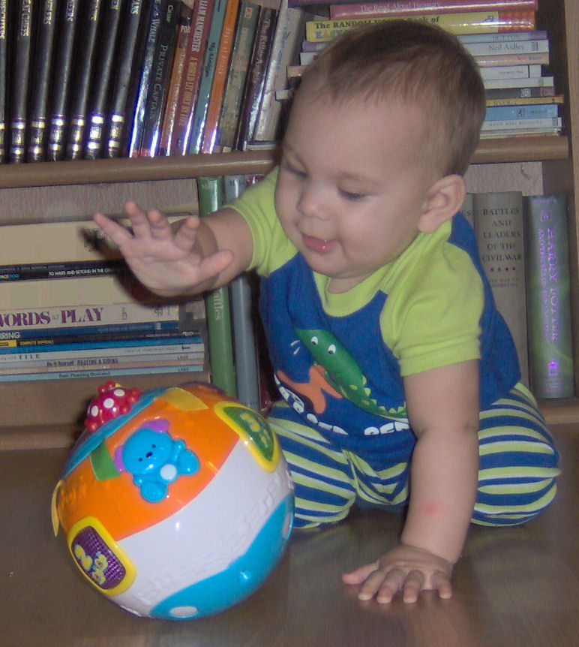
This child is “playing”
Actually
hard at work
Maintaining balance
  Using trunk and hands for support
Eye-hand coordination
Visual and auditory attention
Cause and effect testing
  (I touch the ball, it rolls)
  (I touch this button lights turn on)

Slide 40
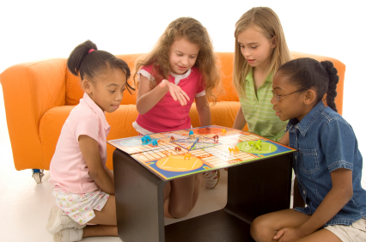
Playing a board game
1. understanding how the game is played- cognition and memory
2. keeping track of whose turn -visual and auditory attention
3. social interaction
  Taking turns, being a “good loser”-

Slide 41
Playing a board game (continued)
Targets Executive Function skills
  Flexibility
  Shifting from one thing to another
    Emotional regulation
    Frustration tolerance
    Planning –strategy

Slide 42
Types of Play
Unoccupied Play (First appears Birth to 3 months)
  working on coordination of gross and fine motor skills
Solitary Play (First appears 3 months to 18 months)
  exploring world
  other children nearby but do not interact
Parallel Play (First appears 18 months to 2 years but can be present at any age)
  play alongside other children without any interaction,
  learns concepts of “mine”, begins associations with other children
Onlooker Play (Starts in toddler years but can occur at any time)
  learning how to relate to others, learning language

Slide 43
Types of Play (continued)
Associative/Social Play (First begins 3 to 4 years of age)
  Loosely organized play
  Interested in socializing with other children
  Learn do’s/don’ts of interacting: sharing, language development, problem solving
  Learns social rules
Cooperative Play (First begins late preschool period)
  One leader
  Games have rules

Slide 44
Another way to categorize play
  Motor play
    Run, jump, play ball, hide and seek, tag
  Constructive Play
    Playing with blocks, drawing, exploring objects, discover patterns, problem solving
  Expressive Play
    Multi-sensory
      Visual (paints, crayons for drawing),
      Tactile (clay, water, sand)
      Auditory (musical toys or toys that make noise)
  Fantasy Play
    Uses imagination (dress-up, role-playing)

Slide 45
Play and children with autism spectrum disorders
Play is more repetitive and less flexible
Skills don’t progress in typical developmental sequence- exploratory to relational to functional to symbolic play
  Exploratory play is prolonged
  Functional and symbolic play is limited
Limitations in communication and social interaction impact independent of the desire to play

Slide 46
Fostering physical, language, cognitive and social development through play
Answer the following questions
  1. What is my child able to do?
  2. What is my child in the process of learning?
  3. What is my child not able to do yet?

Slide 47
Fostering physical, language, cognitive and social development through play continued
1. Don’t worry about what your child “should” be able to do- age-wise
2. Tailor your play expectations to where your child is currently functioning

Slide 48
Best practice
Programs should target
  Attending to relevant aspects of environment
  Developing verbal and motor imitation skills
  Developing language comprehension
  Developing functional communication
  Learning toy play skills
  Developing social interaction skills with same age peers (typically and non-typically developing)

Slide 49
Developmental Tasks
Successful integration of three elements:
  A. emotional regulation and increased frustration tolerance
  B. shift from literal reasoning to abstract reasoning/ problem solving
  C. goal-directed action with requirements of increased planning and organizational skills

Slide 50
Inhibition and Cognitive Flexibility
Control impulses and modulate emotions
  Children are expected to develop more impulse control as they become older
  A 2-year-old will take a desired toy in the store unless parents prevent it.
  A 13-year-old is expected to inhibit the response of taking the toy. He or she can stop own behavior at proper time

Slide 51
EF Intervention Suggestions
Smart But Scattered (Dawson & Guare)
1. Assess your child’s executive skill strengths and weaknesses
2. Assess your own executive skill strengths and weaknesses
3. Look at the fit

Slide 52
Intervention
(continued)
Understanding Fit
Areas of parent strength and child weakness
  Come to an agreement that child will accept help so that weaknesses don’t get him/her in trouble
  Be creative
  Identify areas where your child has EF strengths

Slide 53
Intervention continued
Understanding Fit
Areas of parent weakness and child weakness
  Have a sense of humor
  Brainstorm solutions
  Before you get exasperated over something your child has done, think about how you grew up with that challenge and overcame it.

Slide 54
Principles for Improving EF skills
Dawson & Guare
Teach deficient skills rather than expecting the child to acquire them independently
Match expectations to developmental level
Start with external cues and move to internal cues
Cues include environment, task itself and your interaction
Use, rather than fight, child’s drive for mastery and control
Pay attention to the effort requirements of the tasks
Use incentives
Provide just enough support so that the child can be successful
Keep supports and supervision in place until child achieves success
Withdrawal of support, incentives and supervision should be gradual

Slide 55
Contact Information
Louise O’Donnell, Ph.D.
University of Texas Health Science Center
San Antonio
Email: odonnelll@uthscsa.edu
Phone: 210-567-6534

Slide 56
One-Sided Conversation

Slide 57

Video provided by: TD Social Skills

Slide 58
Teach Turn-Taking Skills
Talk Stick
Board/Video Games
Set Sayings: “My Turn, Your Turn”
Conversation Prompt/Talk Card
Video Modeling

Slide 59
Bullying

Slide 60
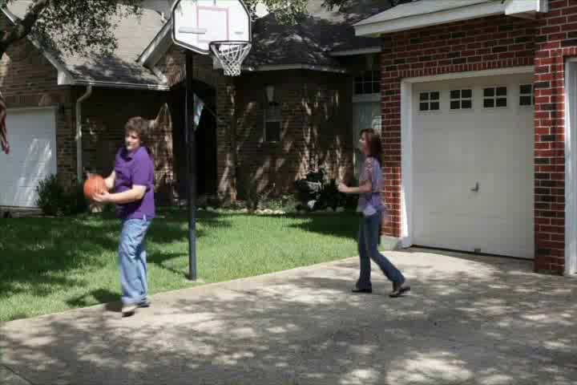
Dr. Tony Attwood

Slide 61
Solutions to Bullying
Share your problems with someone you trust
The less of a reaction you give, the less the bullies will bother you
Value your friends more than your enemies
Don’t be a low-risk target who’ll keep their problems to themselves
Feel sorry for the bullies. Hard but important! Be grateful that you’re you rather than them
Never forget how much you’re worth
In a few years, the bullies will be gone anyway. Remember once
you leave school, you’ve left it forever
8. If it comes to it, there are difference ways of being educated
By: Chris Bonnello/Autistic not Weird

Slide 62
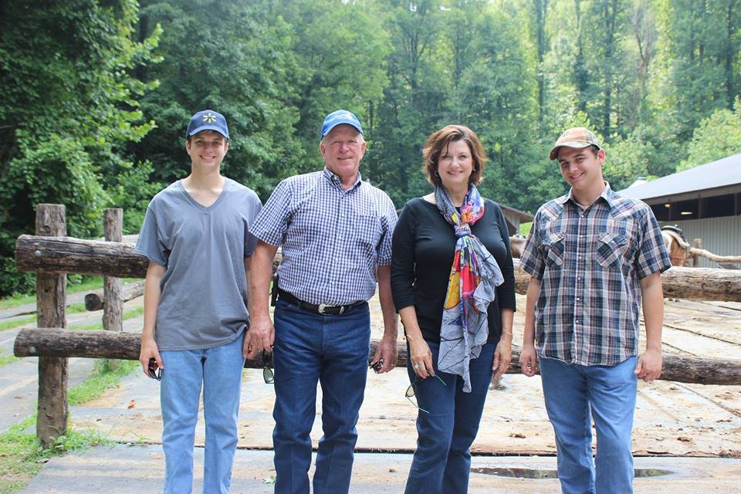
Listen to your child
Pick you battles
Develop your ‘team’
Talk with your child
Develop and work your plan

Slide 63


Q & A
Panel of Experts:
Dr. Berenice de la Cruz, Ph.D., BCBA-D, Chief Operating Officer Autism Community Network
Dema Stout, MA, PCC, CPCC, Greatness Coaching
Janet Enriquez, Autism Education Specialist, Region 20
Dr. Louise O’Donnell, Ph.D., Assistant Professor of Psychiatry, UT Health Science Center
Dr. Ghia Edwards, Psy.D., Behaviorist
Samuel Allen, A.A., College Student diagnosed with Asperger Syndrome, Recipient TCASE Student of the Year
Jennifer Allen, Founder & CEO Aspergers101, Parent of a child with Autism, Author
Message your questions to: WOAI-TV
KABB-TV
Aspergers101

Slide 64
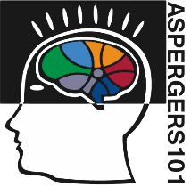



Thank you for attending
Asperger Syndrome:
From Diagnosis to Independence
This evening has been recorded and will be made available to all online
at: www.aspergers101.org/summerseries

